Slide 1

CSD 2214 Section 5 JavaScript Technologies Course Project

Slide 2

Term Project & Presentation - 25%
Employ Ajax and JSON with the API for Google Maps to get display markers and messages on a map, and display driving directions on a web page.

Slide 3
Where to get your Google Maps API Key:
https://console.developers.google.com/getting-started?pli=1

Slide 4

Project Deliverable and Grading Ruberic
What you are to Deliver:
A GitHub Repository with all your Code and Content, including a SUMMARY PAGE
An email to Peter.Sigurdson@CestarCollege.com with:
Your Name, Email and Student Number
CSD2214 Section 5
Your GITHUB URL
Your Google Sites URL
A Summary Page called SummaryPage in your GitHub Repo with the URL of your Google Sites Web page.
Your primary work item in this project will be to figure out how to add at least 6 location mash ups to your map!
Good Luck!

Slide 5
Project Deliverable and Grading Ruberic
Final Deliverable operates correctly. Google Sites Page Displays your Google Map with Location Pins Mashup | 25%
Packaging up the Deliverable according to Project Requirements (Email sent to Instructor with all information, GITHUB Repository complete with all code and Summary Page) | 25%
Proof of Work as demonstrated by attendance in class and frequent GITHUB Commits | 25%
Presentation to instructor and instructor observation of your work practices. This includes demonstrating adding at least 6 Location Mashups to your starter Google Map. | 25%

Slide 6

Mashups

Slide 7
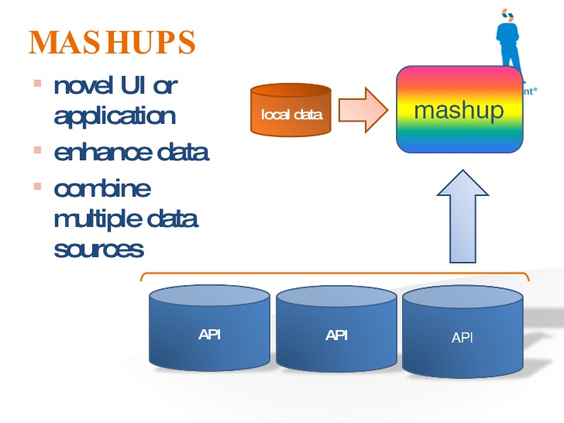
Creating Mashups with JavaScript APIs
JSON
Ajax
Google Maps
Open Weather
Other data sources: Twitter, Instagram

Slide 8
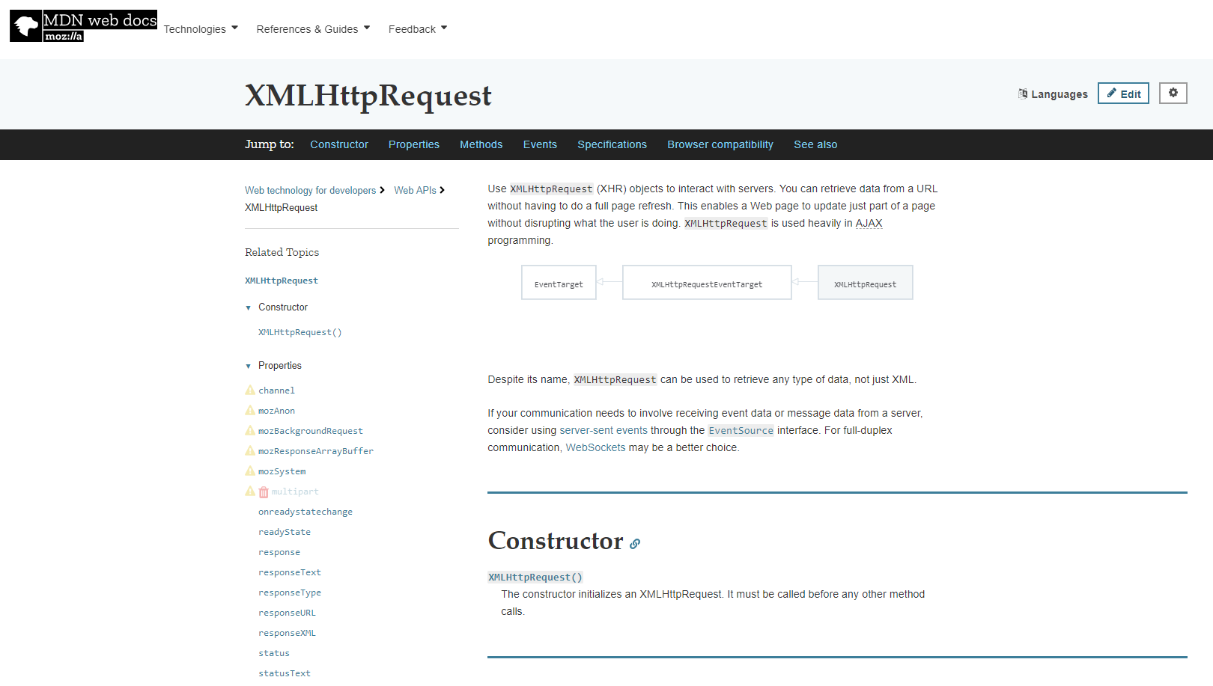
https://developer.mozilla.org/en-US/docs/Web/API/XMLHttpRequest

Slide 9
Project Objectives:
Learn how to embed a Google Map to your homepage and how to customize it with step-by-step instructions and examples.
Create Google Maps to your homepage that fits to its design and content. A customized map is always more engaging.
If you use personalized map, it can contain more relevant information. In this course you can learn how to embed a map and how to customize it.
By the end of this project, you will be able to create Google Maps for your own uses.
Key Skills Learned:
Obtain an API key,
Set up your very first map,
Put markers on it,
Set its appearance with setting styles,
Use the controls with the new UI (v3.22)
Handling events,
Displaying info-window,
Draw lines and shapes,
What you’ll learn
Learn, how to embed a Google map to a website using Google Maps API.
Customize basic elements on the map, such as styles, markers, shapes and so on.
Get familiar with the new UI. (v3.22)

Slide 10
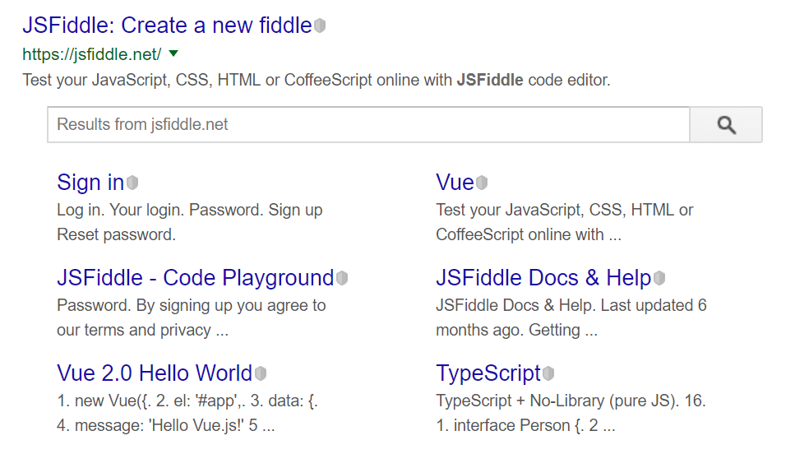
JSFiddle

Slide 11
Obtaining a Google Maps API
https://developers.google.com/maps/documentation/embed/get-api-key
Obtaining an API key: Step-by-step
Visit the Google APIs Console and log-in with your Google Account.
Click the Create Project button. (If you don't have a project yet.)
Fill the Project name edit field.
Click the Create button.
Click the APIs link from the left-hand menu.
Find and select the Google Maps JavaScript API.
Enable API by clicking the button.
Choose the Credentials from the left-hand menu.
Click Add credentials and select API key.

Slide 12
Create a GIT Repository using PowerShell and create a Visual Studio Code Project.
Call your GitHub Repository: MASHUP_Project
Type the Source code from the Project Hardcopy Materials. Save as index.html.
Replace the API_KEY with your key string.
Try to modify the zoom level and the center of the map.
Save the file and open it in the browser. Here are some coordinates (Latitude, Longitude) to practice but you can also try your own pairs:
Tour Eiffel, Paris: 48.858437, 2.294494
Colosseum, Rome: 41.890204, 12.492365
The Great Pyramid at Giza: 29.979262, 31.134218
Opera House, Sydney: -33.856978, 151.215233
Golden Gate Bridge, San Francisco: 37.818191, -122.478388
Machu Picchu, Peru: -13.163167, -72.544966
Tip:
If you want to know the exact coordinate of a specified place, follow these steps:
Open the Google Maps
Find the place on the map (eg: search for address)
Click on the location with the right mouse button
Choose the menu item: "What's here?"
The coordinates will appear in a small box at the bottom of the map.

Slide 13

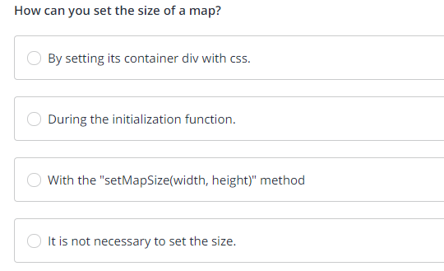

Notes:
Set its container DIV with CSS

Slide 14

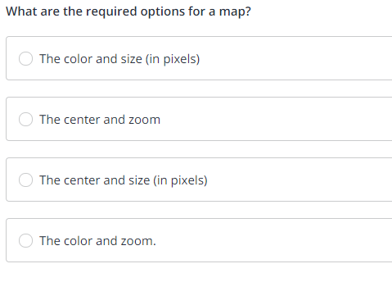
Notes:
The center and zoom

Slide 15

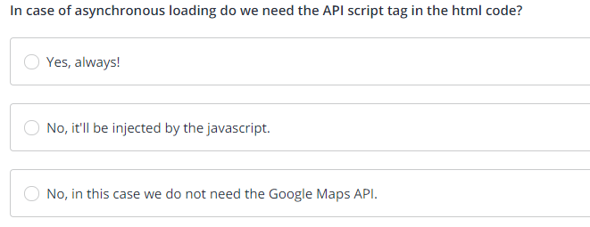
Notes:
It will be injected by the JavaScript

Slide 16

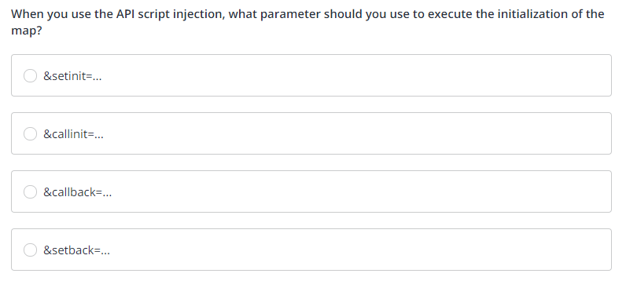
Notes:
&callback=

Slide 17
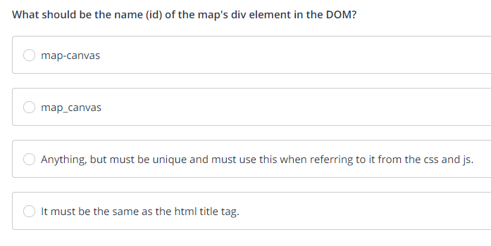


Slide 18
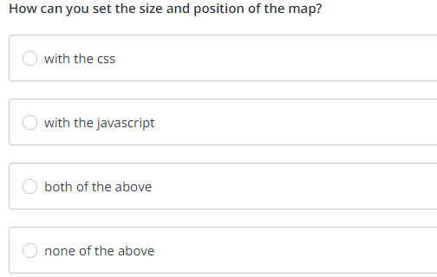


Slide 19
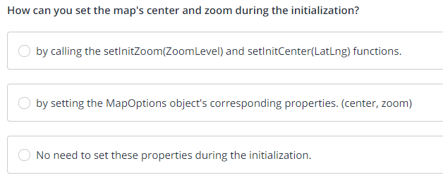

Notes:
by setting the MapOptions object's corresponding properties, (center, zoom)

Slide 20

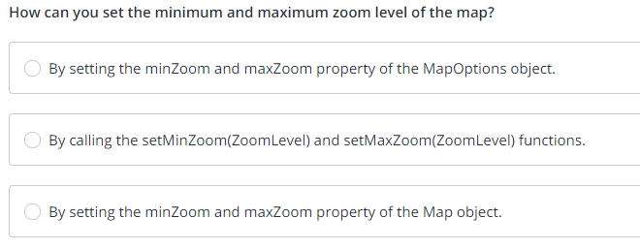
Notes:
By setting the minZoom and maxZoom property of the MapOptions object.

Slide 21
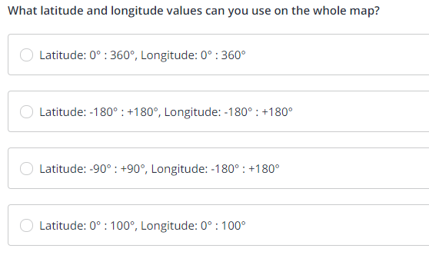
Notes:
Latitude: -90° : +90°, Longitude: -180° : +180'

Slide 22

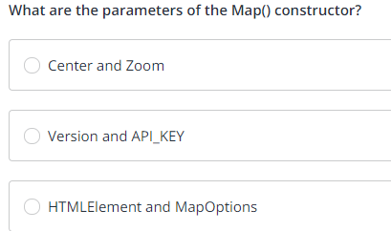
Notes:
A HTML ELEMENT and Map Options

Slide 23
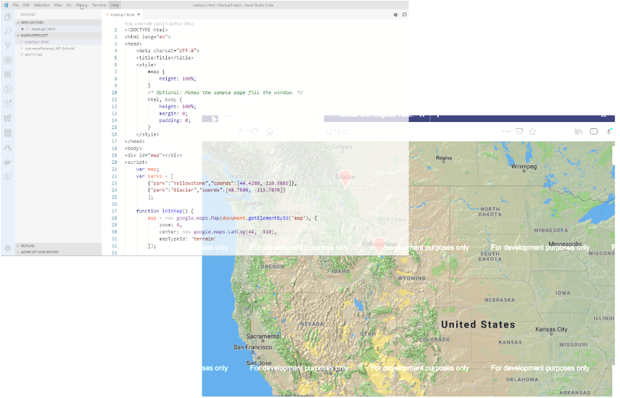
Get the Startup code:
https://github.com/PeterSigurdson/WebServiceMashupsProject/blob/master/GoogleMapsMashupStarterCode

Slide 24
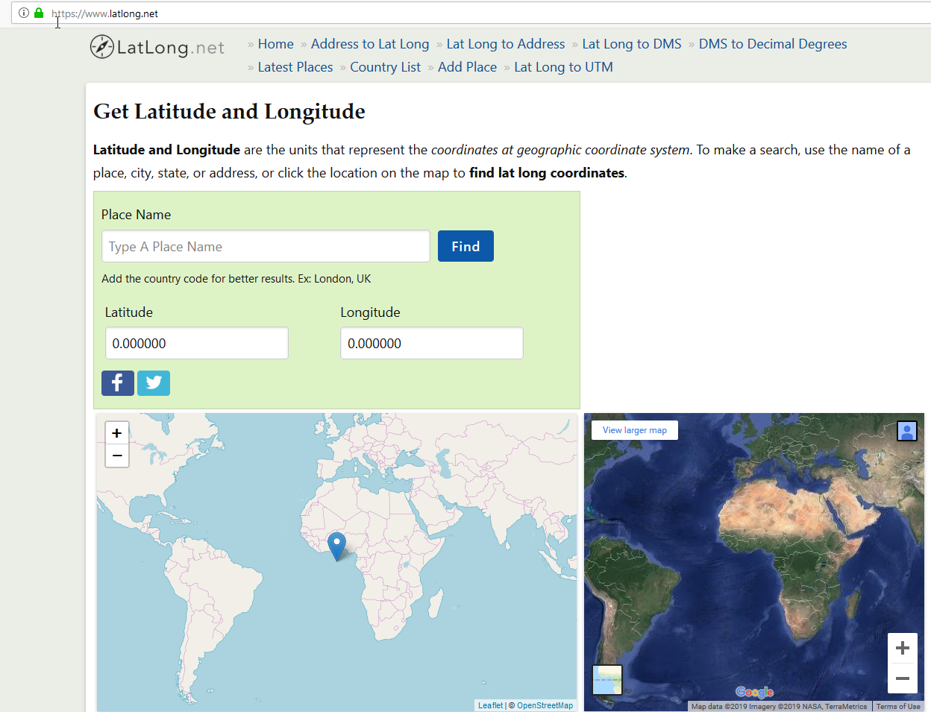
https://www.latlong.net/

Slide 25
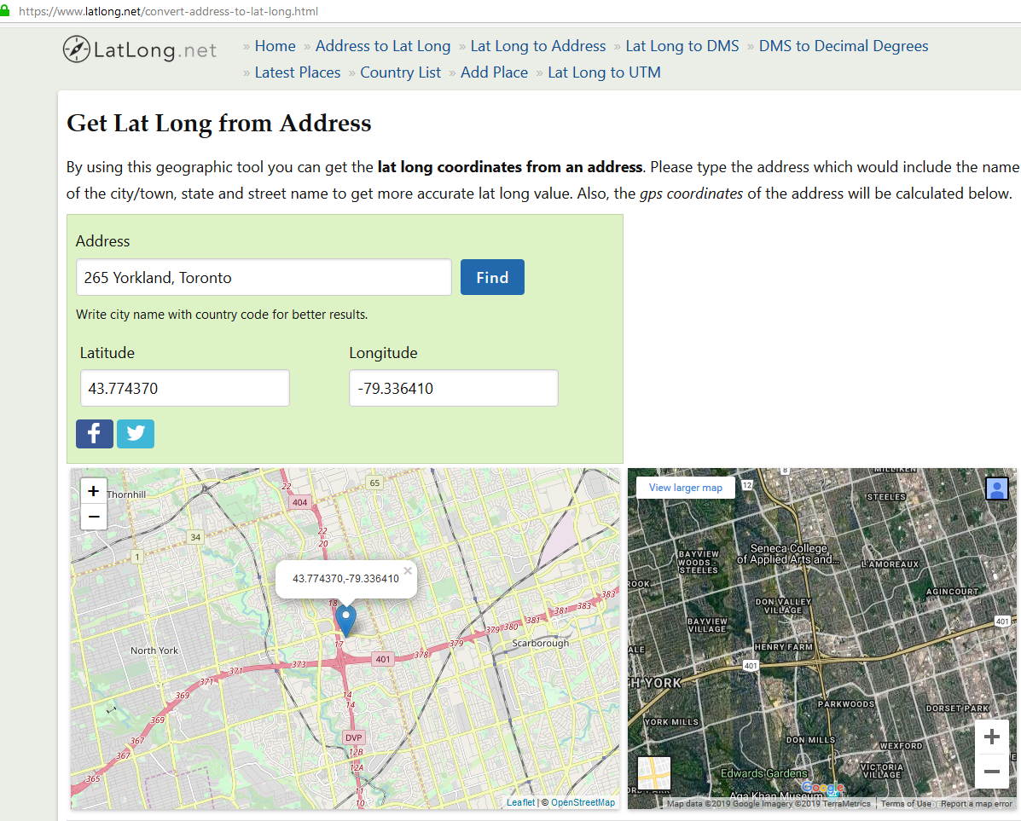

Slide 26
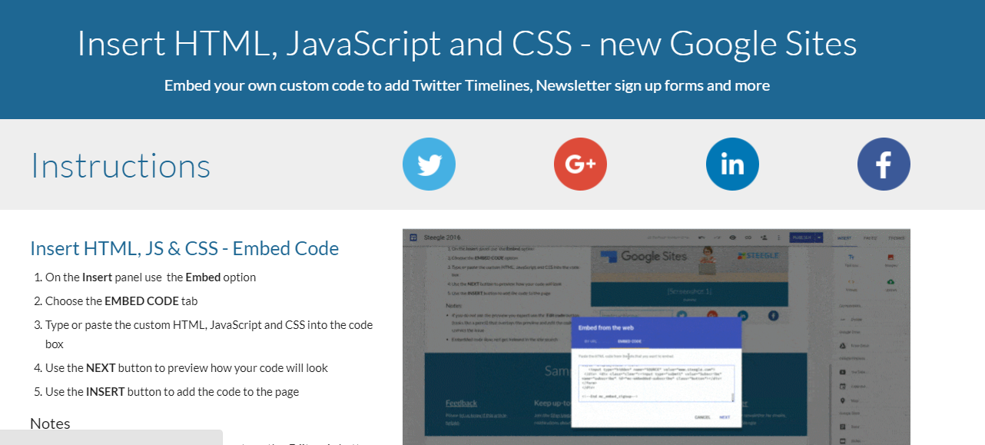
Insert HTML, JS & CSS - Embed Code
On the Insert panel use the Embed option
Choose the EMBED CODE tab
Type or paste the custom HTML, JavaScript and CSS into the code box
Use the NEXT button to preview how your code will look
Use the INSERT button to add the code to the page
Notes
If you do not see the preview you expect use the Edit code button (looks like a pencil) that overlays the preview and edit the code to correct the issue
Embedded code does not get indexed in the site search
Sites displays the embedded code in an iframe so if the code tries to get the URL of the page it will get the iframe URL, not the site's page URL

Slide 27
Project TODO:
Add 6 Locations to your Startup Map, including:
Where you were grew up
Places you have lived
Places you have travelled
Where you are NOW
Create a GOOGLE SITES Website and email the URL of your Google Sites Website to the Instructor, as well as including it in your GitHub Repo

Slide 28
Project TODO:
Email to Peter.Sigurdson@CestarCollege.com:
Your GITHUB REPO URL
Your Google Sites URL
CSD2214 Section 5 Course Project

Slide 29
References
https://github.com/PeterSigurdson/WebServicesAPI
https://www.webucator.com/how-to/how-create-simple-google-maps-mashup.cfm

